Slide 1
Presenter notes
Resources:
Docs: Setting up and managing teams and organizations
Docs: About Enterprise accounts
Docs: Keeping your organization secure
Microsoft docs: Azure AD & GitHub tutorial
Docs: Managing team sync for your organization
Docs: Managing membership in your organization
Docs: Managing people’s access to your organization with roles
Docs: Organization members into teams
Docs: Managing access to your organization’s repositories
Docs: Giving team maintainer permission to an org member
Demo prep:
See 03_team-and-org-UI-walkthrough.docx
FAQ:
On several slides, between sections
Customer stories:
N/A
Expected timing:

Slide 2
Team & organization management
GitHub Bootcamp
@presenter name (optional)

Slide 3
This module will enable you to:
Describe permission models and access structure possibilities on GitHub
Identify best practices related to team and organization management

Slide 4

Team and organization management
GitHub permission model
Enterprise Account vs Organizations
Membership, privileges, and security
Team best practices
Notes:
As we cover Team and Organization management, we will consider the GitHub permission model. We’ll learn how an enterprise account contrasts with organizations. See how to optimally implement organization member privileges and security. Along with that, we will consider membership, roles, and permission levels as well as best practices for teams.
GitHub is mainly known in the context of open source and transparency.
But, GitHub is equally important in the enterprise and intellectual property.
Just because GitHub is known for open source, it is used in many secure and private industries.
GitHub has different levels of security, and give you granular control through team and org management.
Aspects of your development can be open source, but that doesn’t mean it grants access to your secure development information.
********
Resources
https://docs.github.com/en/github/setting-up-and-managing-organizations-and-teams
Learn about Enterprise Managed Users at
https://github.com/github/releases/issues/1012
********

Slide 5
GitHub permission model

Slide 6
Enterprise
Policies
Settings
/enterprises/name
Access
Organizations
External collaborators
Repos
Repo 2
/orgs/name
Access by teams or member roles
Admin
Owners
(Access Roles)
Owners
Maintainer
Members
Members
Triage
Teams
Have parent and children teams
Billing Manager
Read
Maintainer
Write
Members

Slide 7
What's possible?
Customize access
Granular permissions
Notes:
The GitHub permission model is available with Cloud and Server.
It is important to recognize that this exists. Often, when people refer to GitHub, they think of open source. So, this means that they may be thinking of code being available openly with no restrictions. For companies concerned about a level of access control to their data, knowing about permission levels on repositories and organizations is crucial.
You can customize access to each repository in your organization with granular permission levels, giving people access to the features and tasks they need.
********
Resources
https://docs.github.com/en/github/setting-up-and-managing-your-enterprise/about-enterprise-accounts
********

Slide 8
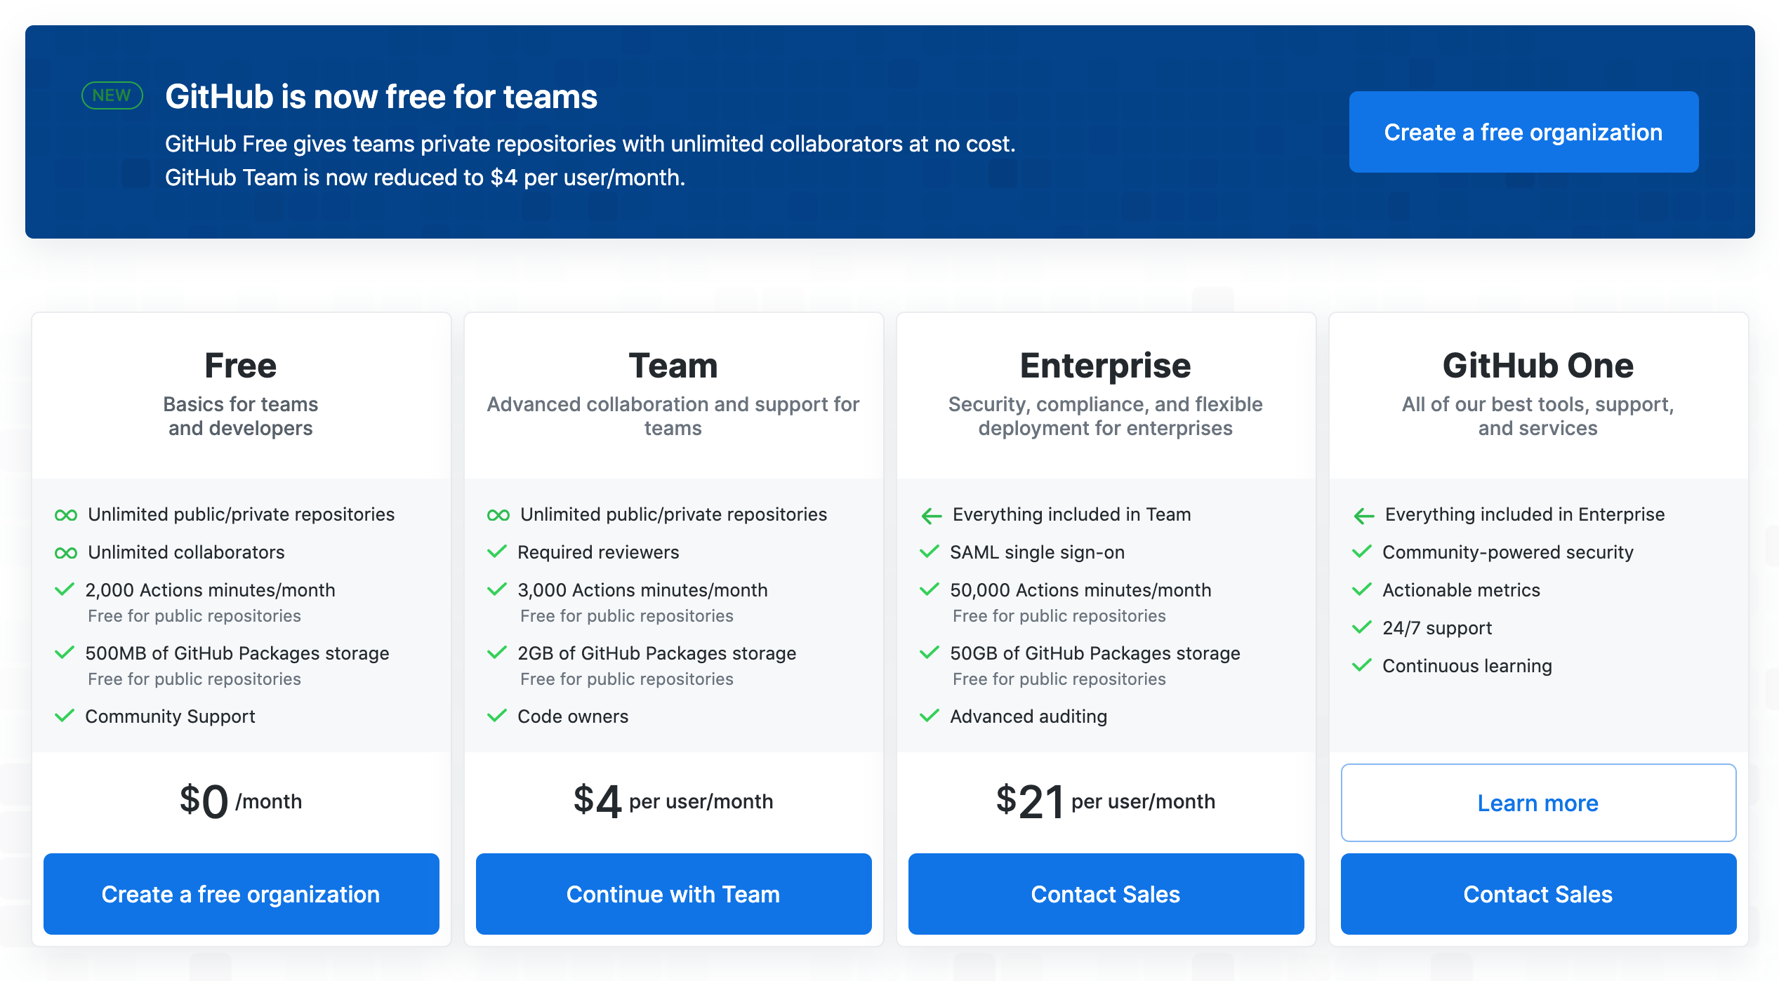
Notes:
Focusing on enterprise
***********************
Note to presenter: Always check to make sure that this slide is current. Focusing on Enterprise
Not intended to talk about Sales, but important to talk about the customer’s view about the relationships between the models
***********************
This pricing table illustrates the relationship between the models.
Reference: https://github.com/pricing

Slide 9
Enterprise vs. organization accounts

Slide 10
Account Types
Enterprise accounts enable collaboration between your organizations
Organization accounts allow businesses and organizations to collaborate across projects.
Notes:
Available with Cloud and Server:
Enterprise accounts - A sort of umbrella to enable collaboration between your organizations. Admins have a single point of visibility.
With GitHub Enterprise Cloud, you can create an enterprise account to enable collaboration between your organizations, while giving administrators a single point of visibility and management.
Organization accounts are shared. Businesses and open-source projects can collaborate across many projects at once. Owners and administrators can manage member access to the organization's data and projects with sophisticated security and administrative features.
********
Resources
https://docs.github.com/en/github/setting-up-and-managing-your-enterprise/about-enterprise-accounts
https://docs.github.com/en/github/setting-up-and-managing-organizations-and-teams/about-organizations
********

Slide 11






Enterprise Account
Cloud (github.com)
Server (self-hosted)
Organization
Organization
Organization
Organization
GitHub Connect
Repository
Repository
Repository
Repository
✅ Search
✅ Contributions
✅ Security alerts
✅ License sync
Repository
Repository
Repository
Repository
Notes:
Cloud Instance
Uses same infrastructure as server
Server (self-hosted) Instance
Appliance
On-prem, Azure, AWS, GCP
Enterprise accounts have organizations and organizations have repositories. Permissions are inherited. Users get added to the enterprise by having access to the organizations that are within the enterprise.
GitHub Connect unifies only search, contributions; and optionally security alerts and license sync.
********
Resources
https://docs.github.com/en/enterprise-server@3.0/admin/configuration/managing-connections-between-github-enterprise-server-and-github-enterprise-cloud
********

Slide 12
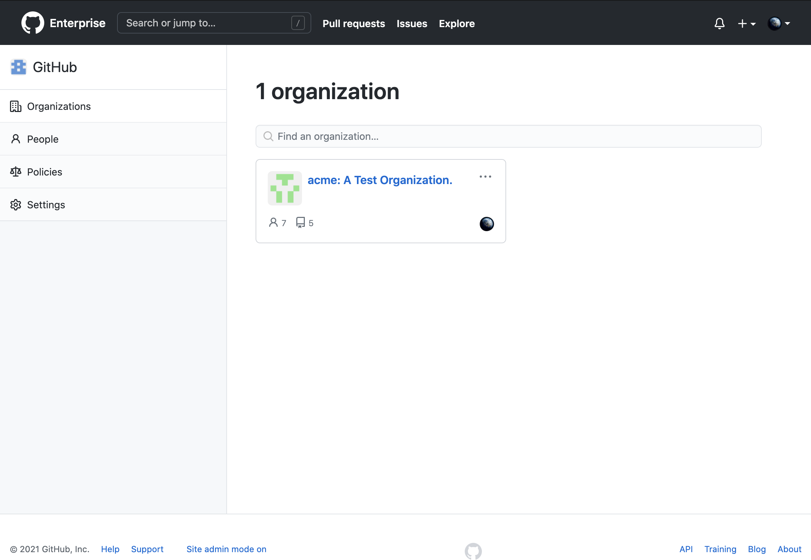
Organization View
Notes:
An enterprise has organizations. The organizations have member which fall into two categories:
Owner - Handles all of the permissions in the organization
Member - Can be there by invitation or through the SSO. Each member consumes a license and can exist in other organizations

Slide 13
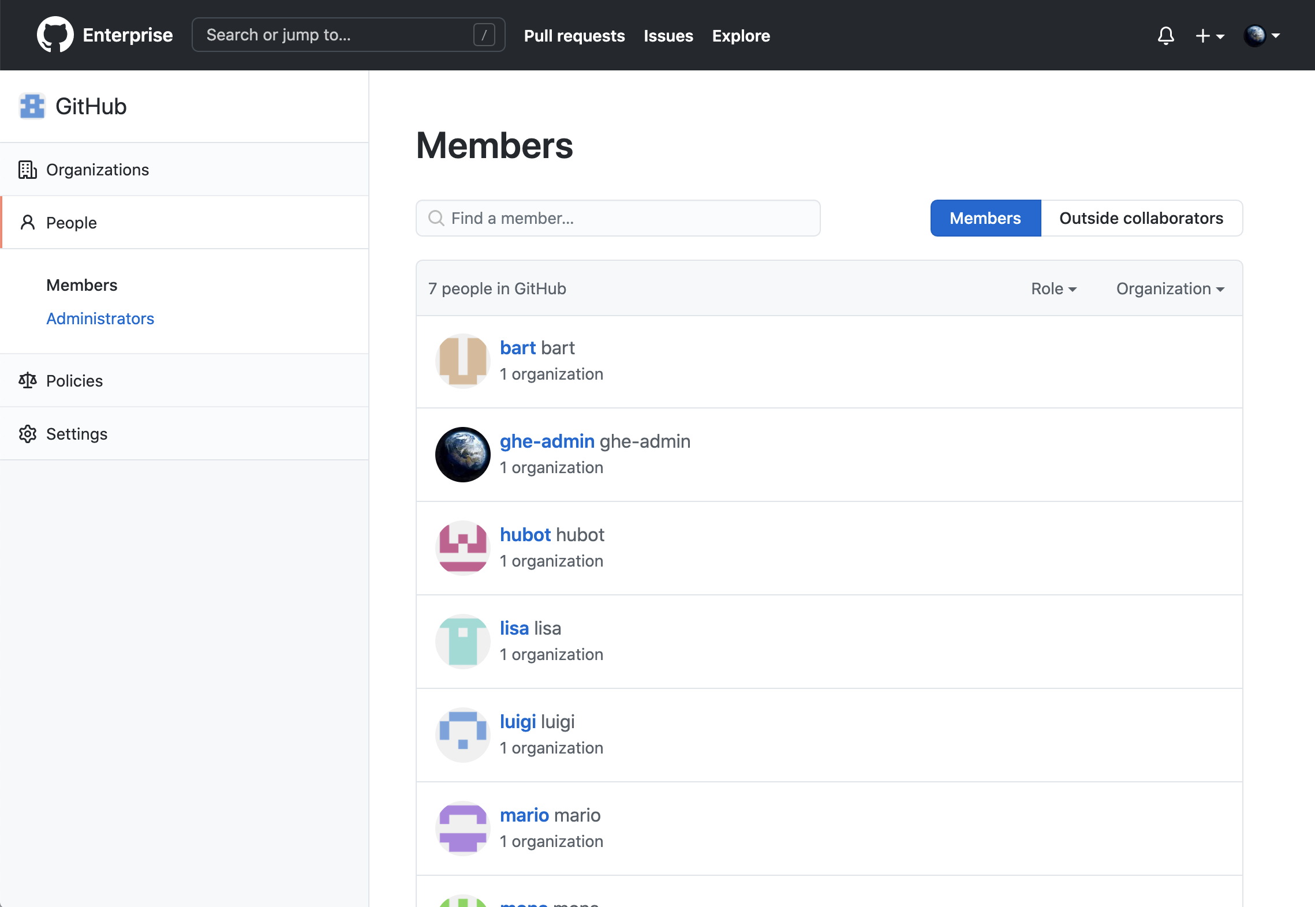
Enterprise Account View
Notes:
For this enterprise account, you can see the various people in your account.
For an enterprise account, there are three roles available:
Owner
Member
Billing Manager (Does not count as a license)
********************
References:
See the table on the following documentation page for details on roles:
https://docs.github.com/en/github/setting-up-and-managing-organizations-and-teams/permission-levels-for-an-organization
********************

Slide 14
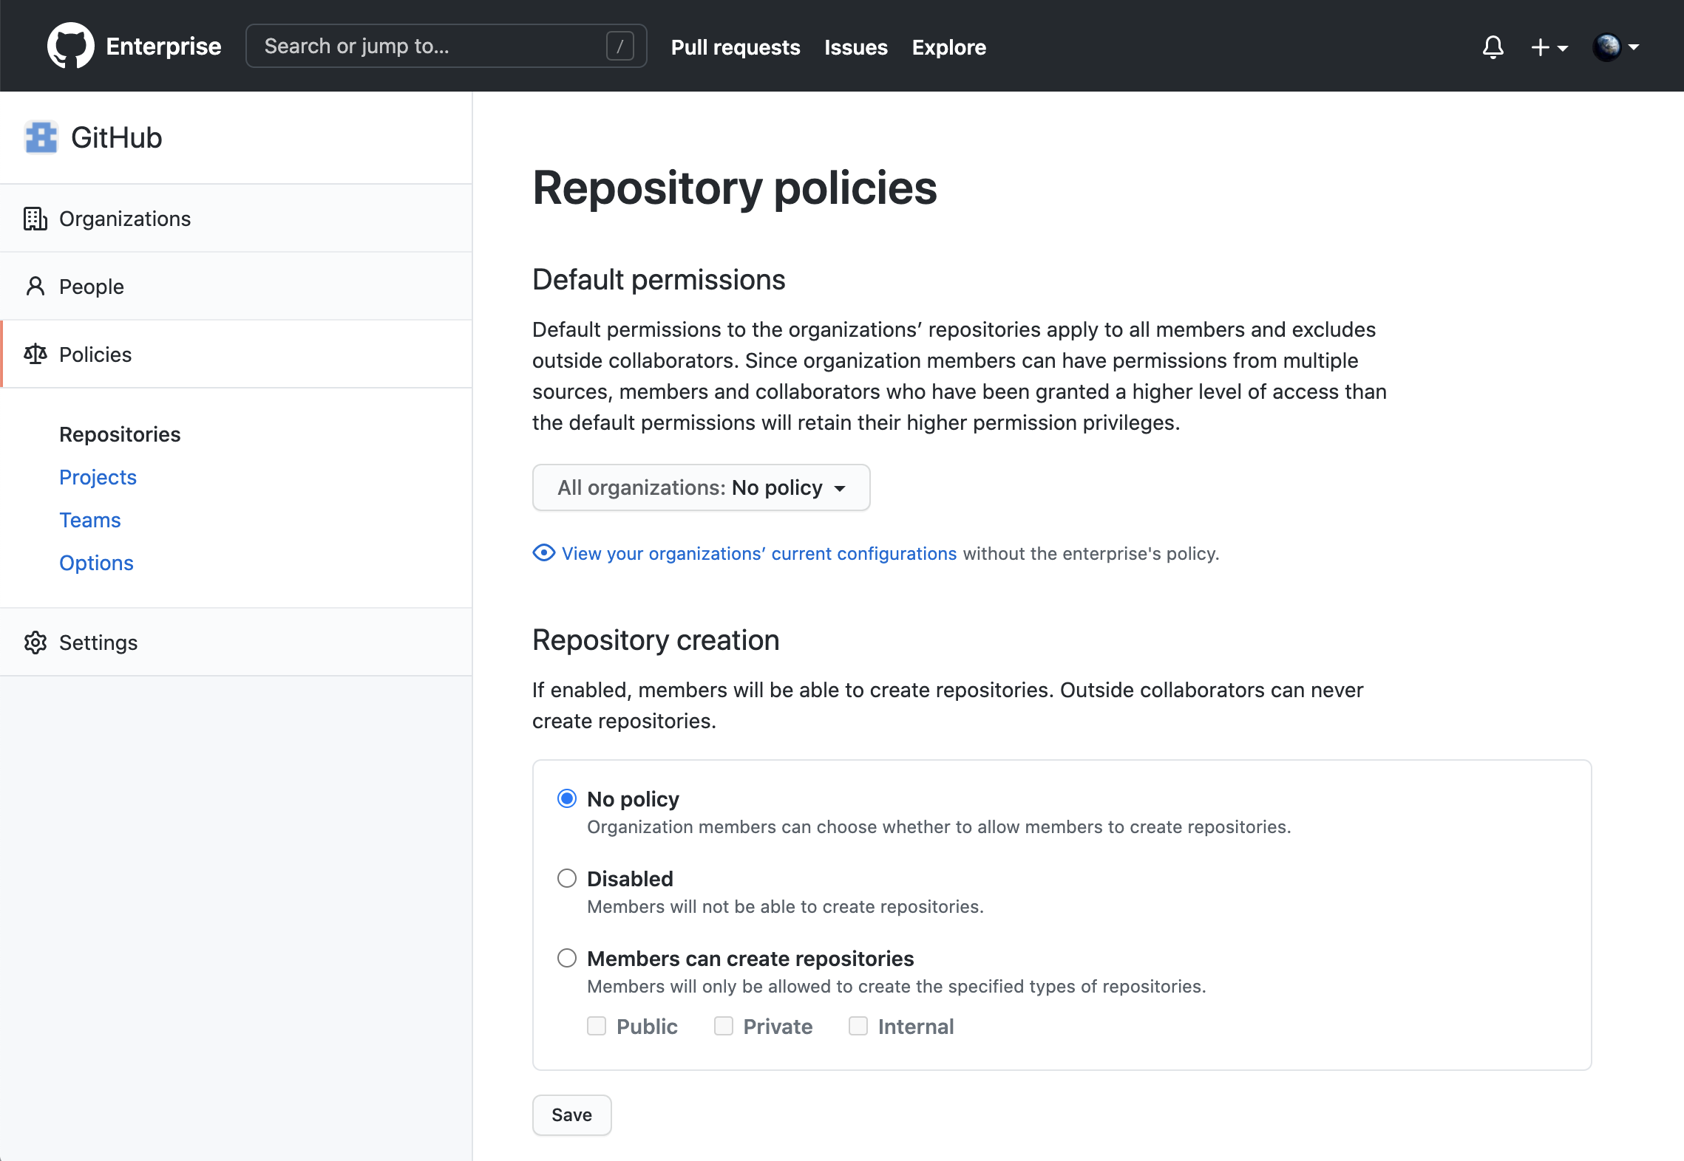
Repository policies
Notes:
You have the option of setting policies at the enterprise account level. Often this is left at its default setting. But, it is good to know you have the option.

Slide 15
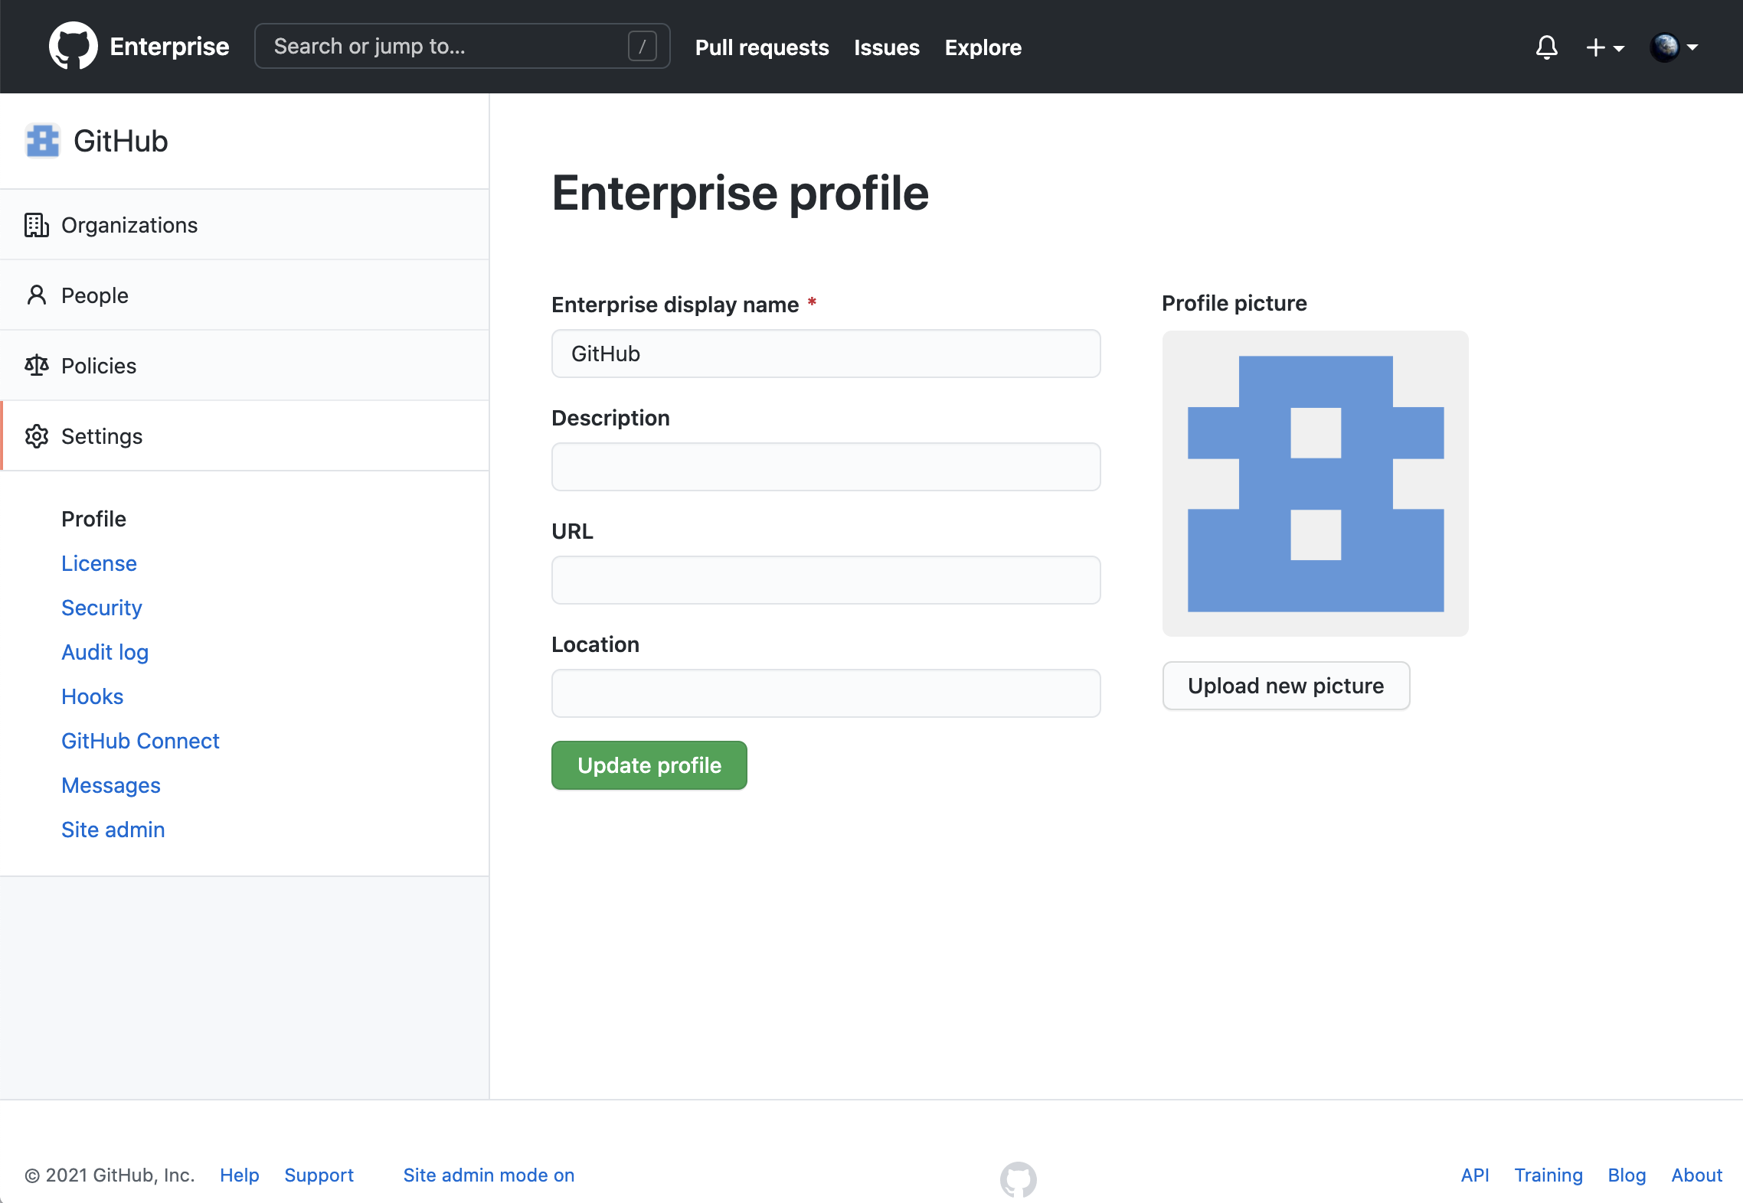
Account settings
Notes:
Settings on the organization level

Slide 16
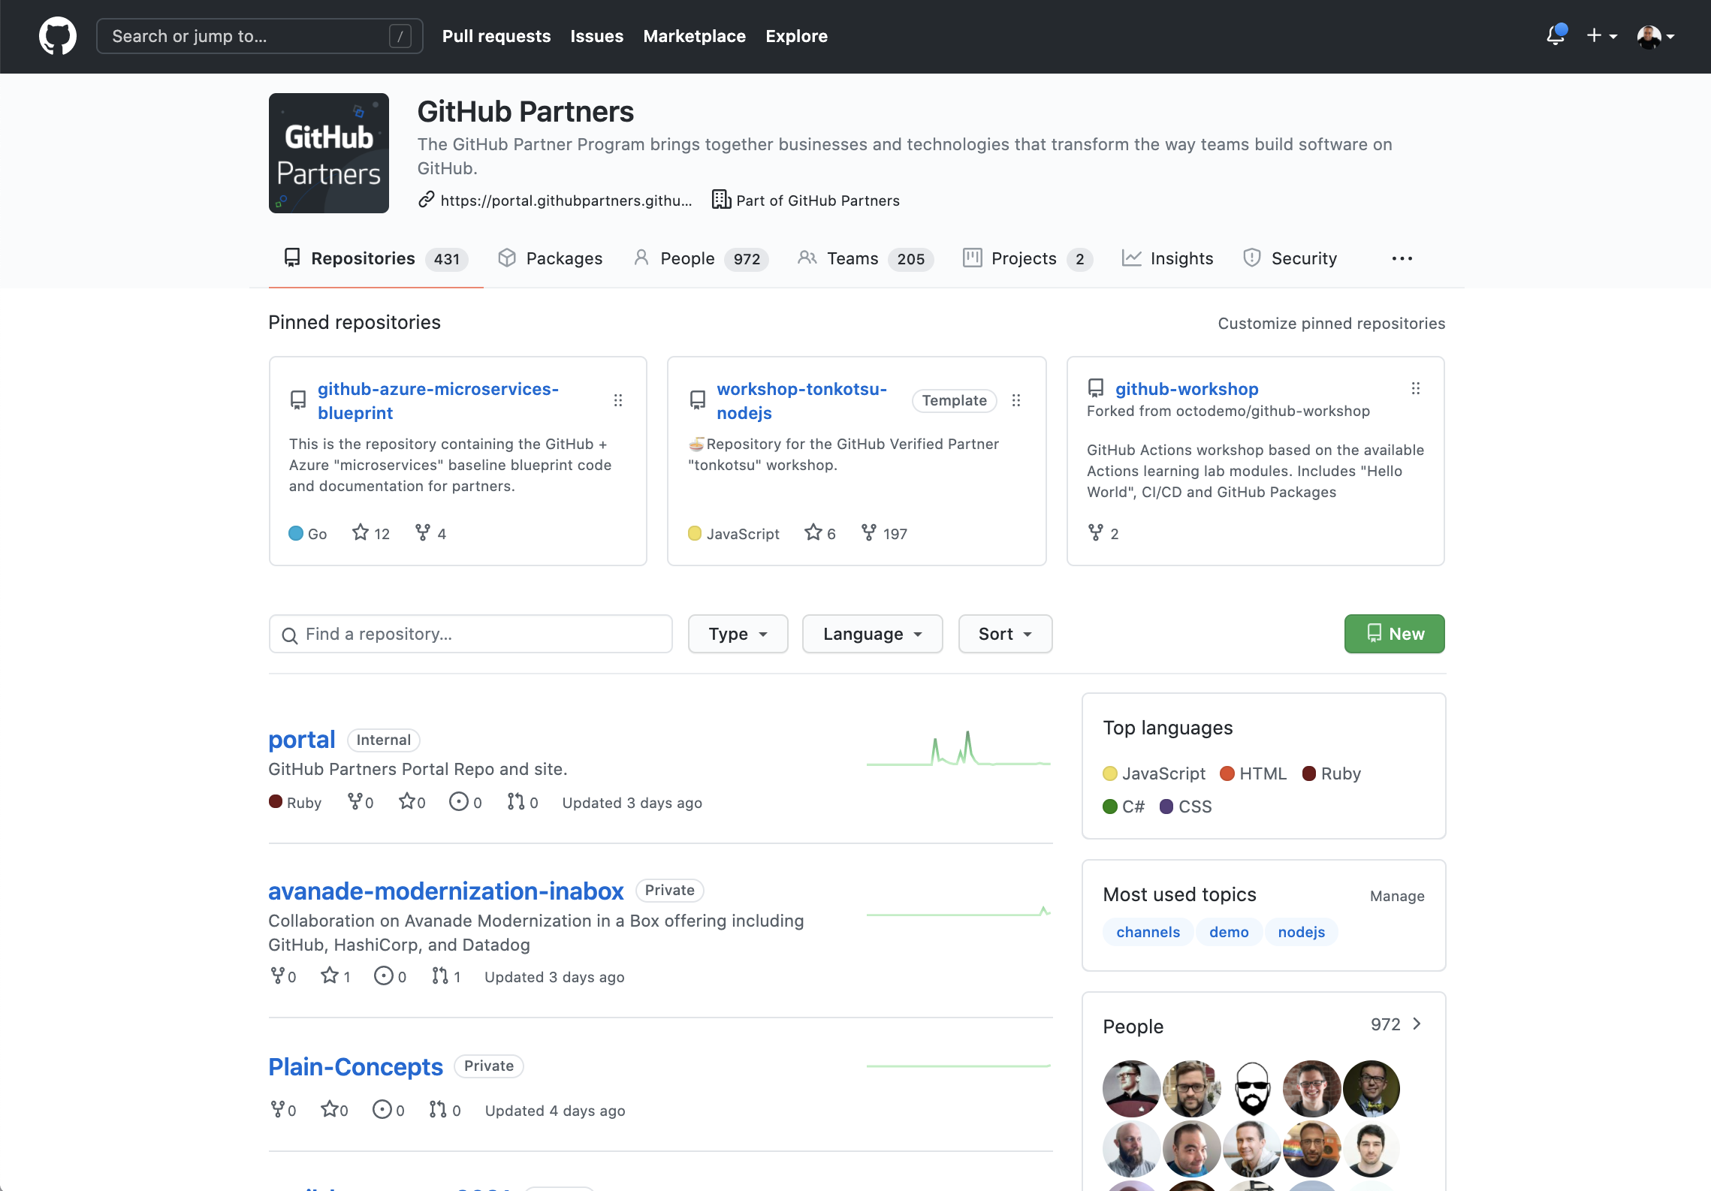
Organization View
Notes:
For organizations that belong to an enterprise account, billing is managed at the enterprise account level.
The screen shows the main page of an organization. From here you can
View and search for available repositories
Create a new repository
Navigate to the areas for packages, people, teams, projects or insights
Reference:
https://github.com/githubpartners

Slide 17
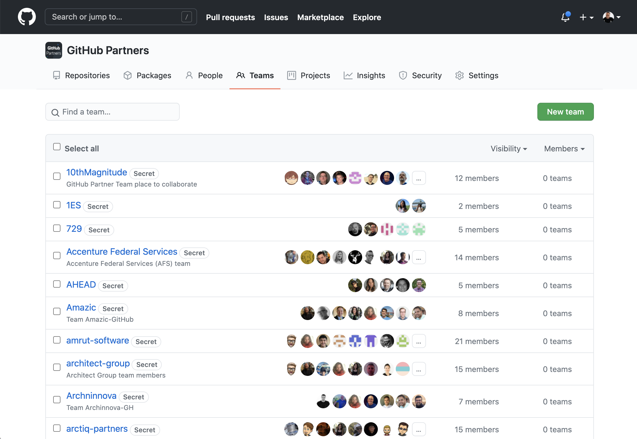
Teams
Notes:
An organization can contain a collection of users organized into teams.
Inside of a team, you can occupy one of these roles:
Maintainer - Administers team settings. Owners inside of organizations are always maintainers of teams. They do not need to be explicitly given those rights.
Member
Reference: https://github.com/orgs/githubpartners/teams

Slide 18
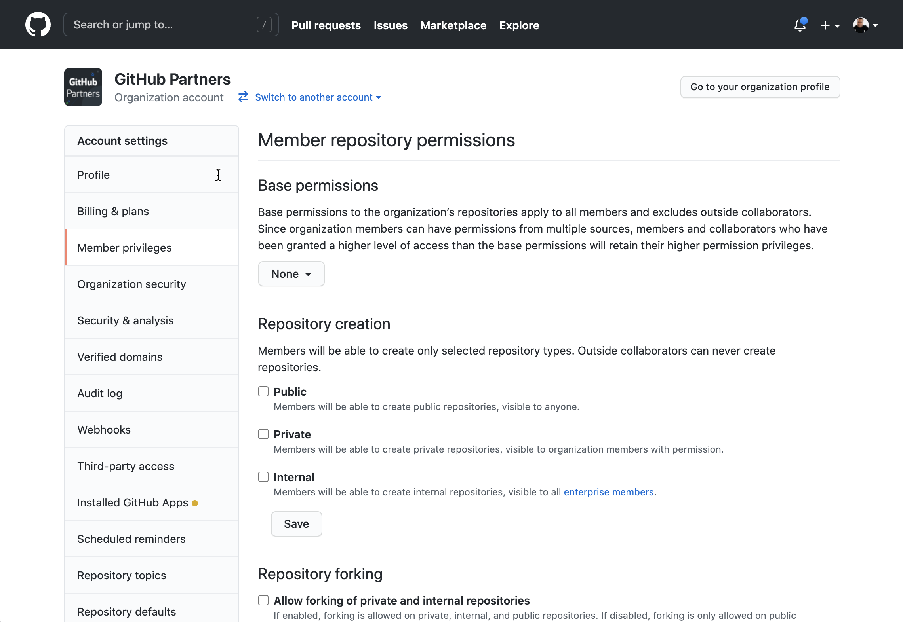
Repository permissions
Notes:
Some of the most fundamental settings in an organization are the base permissions.
Do you want everyone in an organization to have read access?
So, what do you want members of the organization to be able to do by default?
Reference: https://github.com/organizations/githubpartners/settings/member_privileges

Slide 19
Membership, privileges, and security

Slide 20
Member privileges and security
Keep projects and data secure
Audit log
Member 2FA status
Application settings
Notes:
Available with Cloud and Server
Organization owners have several features to help them keep their projects and data secure. If you're the owner of an organization, you should regularly review your organization's audit log, member 2FA status, and application settings to ensure that no unauthorized or malicious activity has occurred
Privileges at an enterprise level - Set policies, create orgs and billing at an enterprise level
********
Resources
https://docs.github.com/en/github/setting-up-and-managing-organizations-and-teams/keeping-your-organization-secure
********

Slide 21

Organization member privileges
Base permissions (None, Read, Write, Admin)
Issue deletion
Repository creation (None, Public, Private, Internal)
Repository comments
Repository forking
Repository discussions
Repository invitations
Team creation rules
Repository visibility change
Dependency insights
Notes:
Base permission
Repository creation - With this setting you have the ability to set the default permissions of repositories (e.g. Should the repos be private only?)
Repository forking - Here you could disable the functionality if desired.
Repository invitations - Invite external collabs
Repository visibility change
Delete issues
Repository comments - comments author profile name
Repository discussions - Read access users to create discussions
Team creation - Allow to create teams
Dependency insights - See the insights

Slide 22
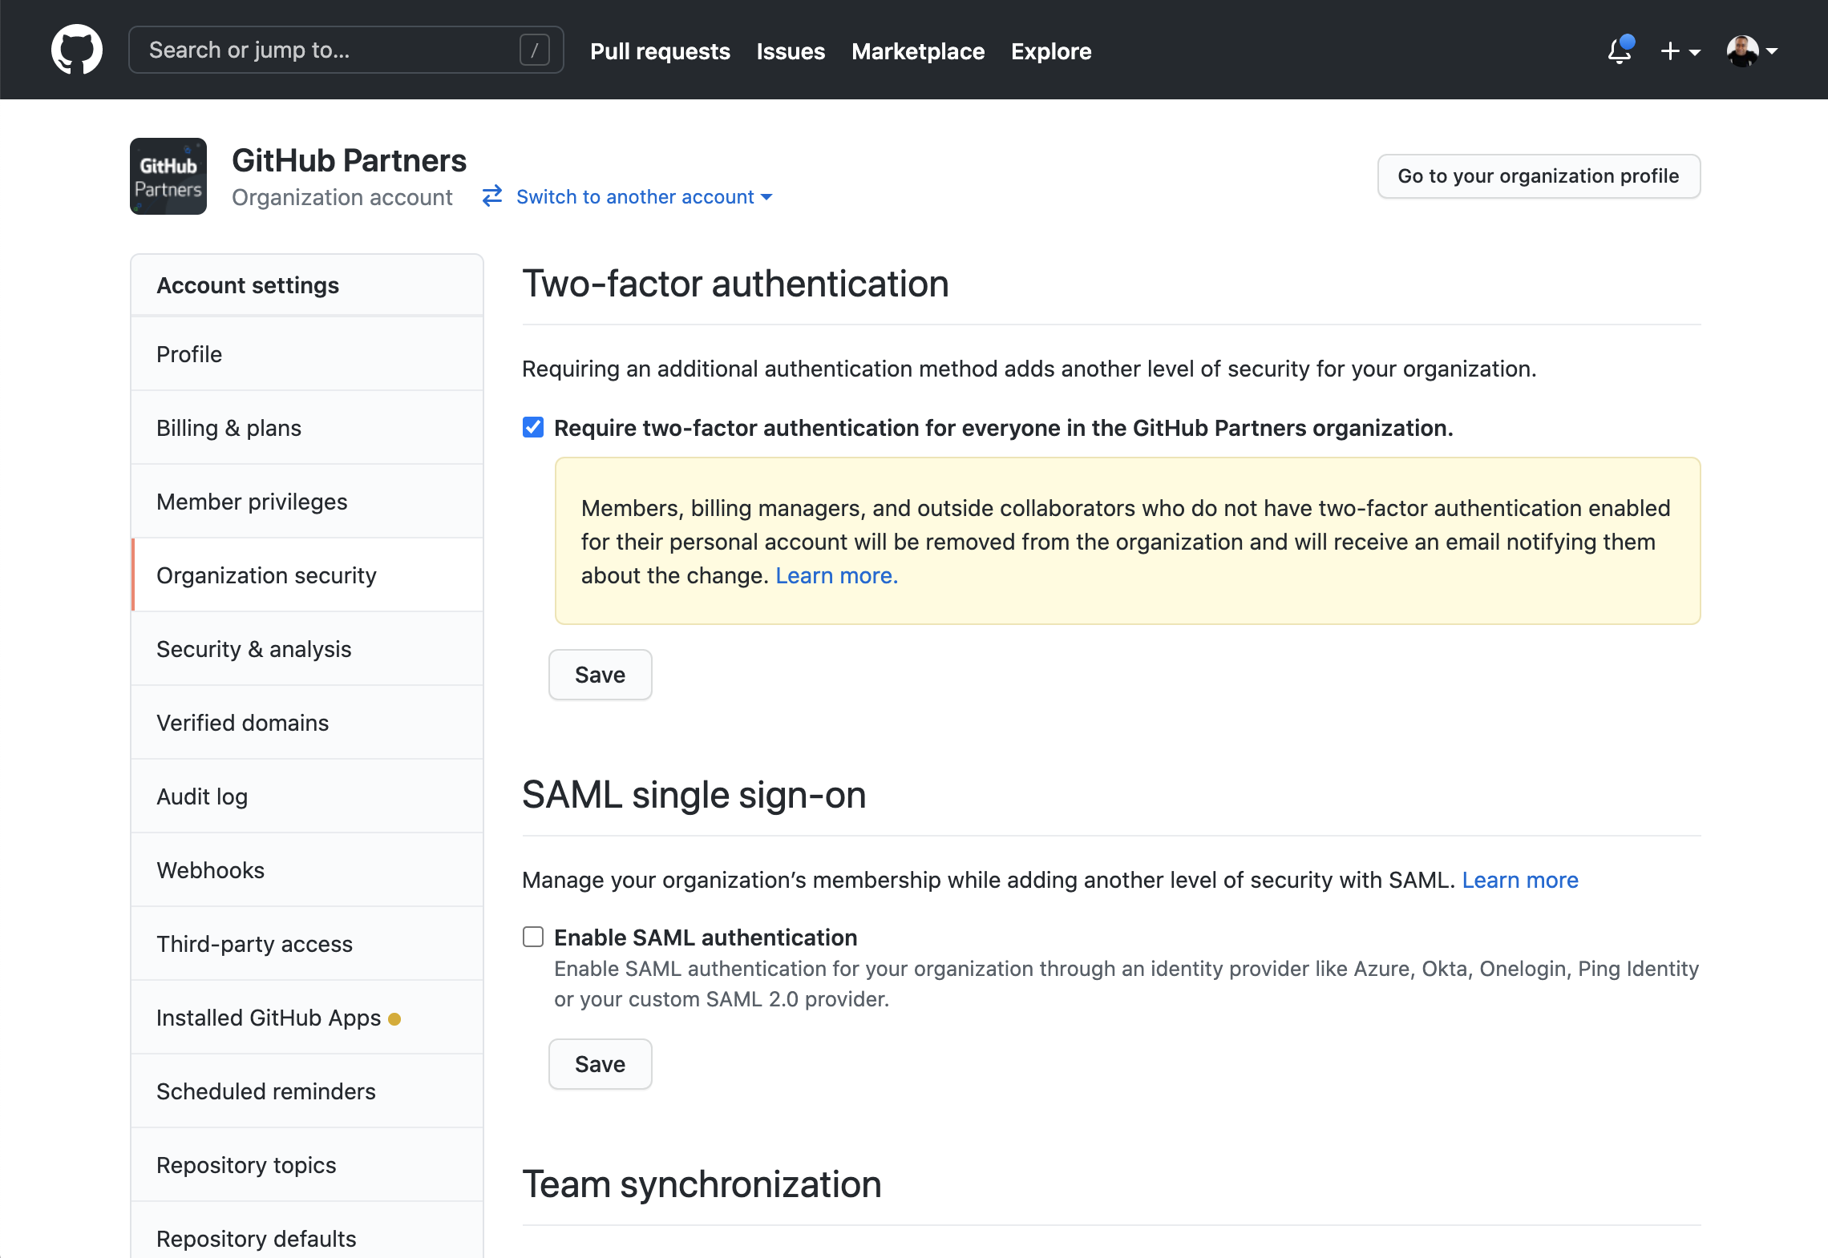
Organization View
Notes:
A really important setting is to require 2FA along with SAML authentication.
The screen shows where this can be set up.
Reference: https://github.com/organizations/githubpartners/settings/security

Slide 23

Organization Security
Two-factor authentication
SSH Certificate Authorities
SAML single sign-on
IP allow list
Team synchronization
Automated security updates
SCIM provisioning
Notes:
Continuing with the concepts…These individual features work together to provide a comprehensive security strategy for organizations.
IP allow list care for migrations to cloud
At this level we can choose to enable Team Synchronization
Note for team synchronization: You can synchronize membership of an Active Directory group to a GitHub team.

Slide 24


Identity providers that support team synchronization
(beta)
Notes:
Although GitHub supports several identity providers in general, in the specific area of team synchronization, only two main identity providers supported: Azure and Okta. See the documentation for details on setting up and managing team synchronization for an organization.
********
Resources:
https://help.github.com/en/github/setting-up-and-managing-organizations-and-teams/managing-team-synchronization-for-your-organization
https://docs.github.com/en/github/setting-up-and-managing-organizations-and-teams/about-identity-and-access-management-with-saml-single-sign-on#supported-saml-services
********

Slide 25





Organization
Repositories
People
Teams
@everyone
Members
Owners
@team1
Contents
Teams and People
@team2
@child -team
Notes:
On this screen we visualize the relationships between the models within an organization
Teams can be nested and are typically created by product

Slide 26
Organization
Repositories
People
Teams
@everyone
Members
Owners
@team1
Contents
Teams and People
@team2
@child -team
Notes:
Relationships of the models within an organization
Teams can be nested and are typically created by product
Teams are not a part of repos and repos are not a part of teams. They are both models of an organization that have a relationship to each other.

Slide 27
Organization
Repositories
People
Teams
@everyone
Members
Owners
@team1
Contents
Teams and People
@team2
@child -team
Notes:
Inside of a repo, you can add individuals. Can be Members or “Outside Collaborators”

Slide 28
UI close-up & ​common practices
UI close-up & ​common practices
Notes:
********
Resources
https://docs.github.com/en/github/setting-up-and-managing-organizations-and-teams/managing-membership-in-your-organization
https://docs.github.com/en/github/setting-up-and-managing-organizations-and-teams/managing-peoples-access-to-your-organization-with-roles
https://docs.github.com/en/github/setting-up-and-managing-organizations-and-teams/organizing-members-into-teams
https://docs.github.com/en/github/setting-up-and-managing-organizations-and-teams/managing-access-to-your-organizations-repositories
********

Slide 29
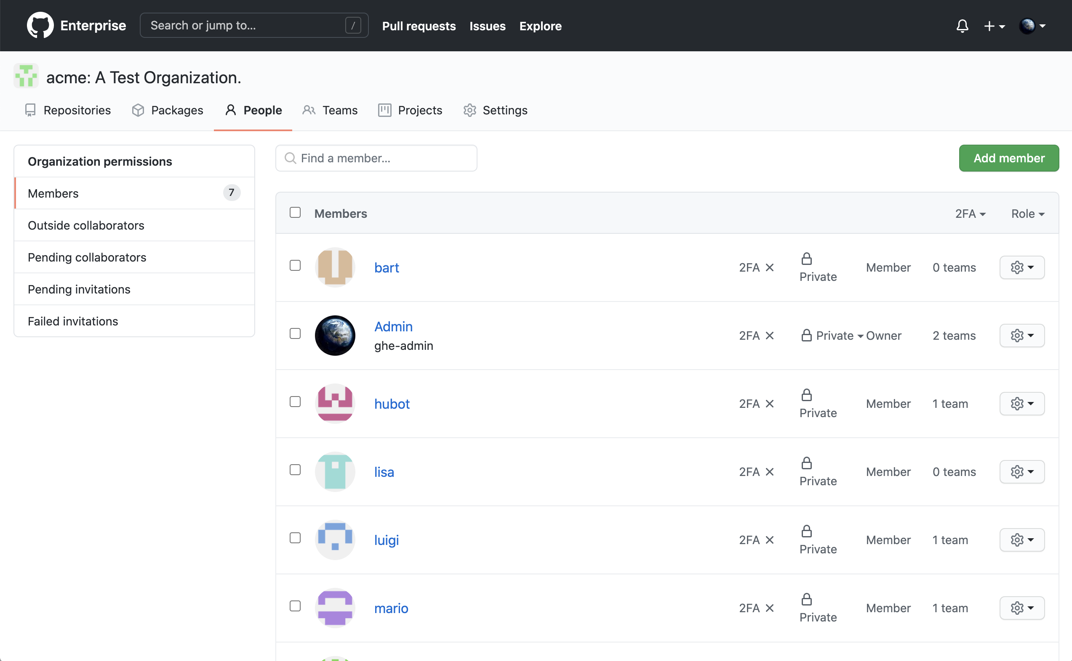
Managing organization membership
Notes:
The main view here shows a number of members, owners, and outside collaborators who have access to one or more repos
It is possible to turn off outside collaborators.

Slide 30

Permission levels for an organization
Owners have complete administrative access to your organization. This role should be limited, but to no fewer than two people, in your organization
Members are the default role for everyone else
Notes:
If someone is in a GitHub organization, they are either an ”owner” or a “member”.

Slide 31
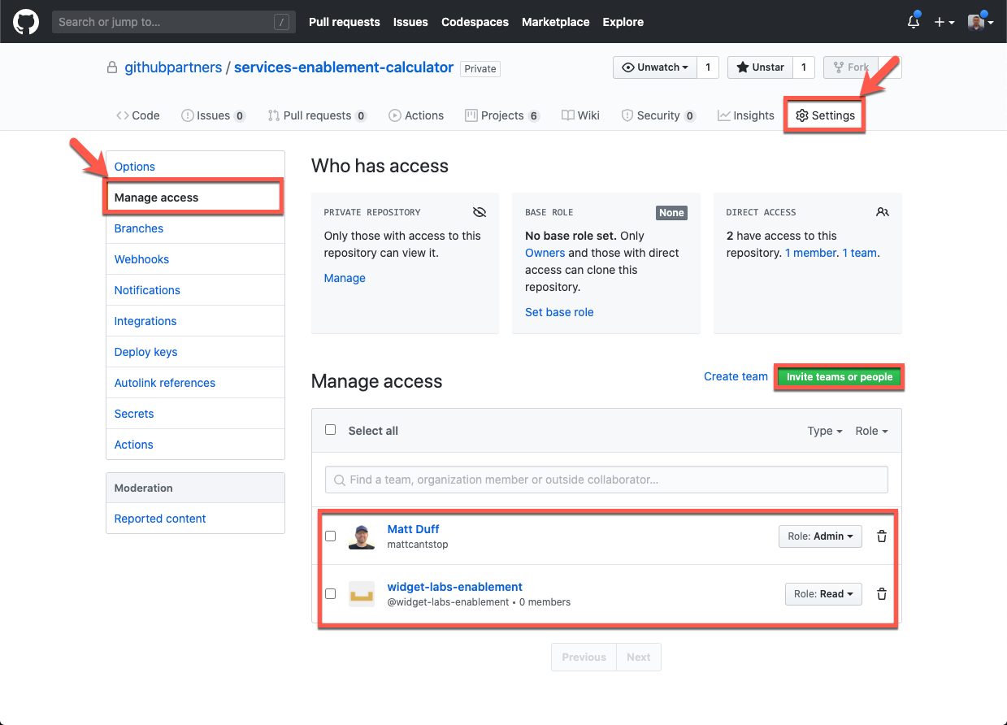
Notes:
We have also updated the UI to give a better view at precisely who has access
Managing access for the repository
You can add:
Members, owners
Teams
Outside collaborators
Reference: https://github.com/githubpartners/services-enablement-calculator/settings/access

Slide 32
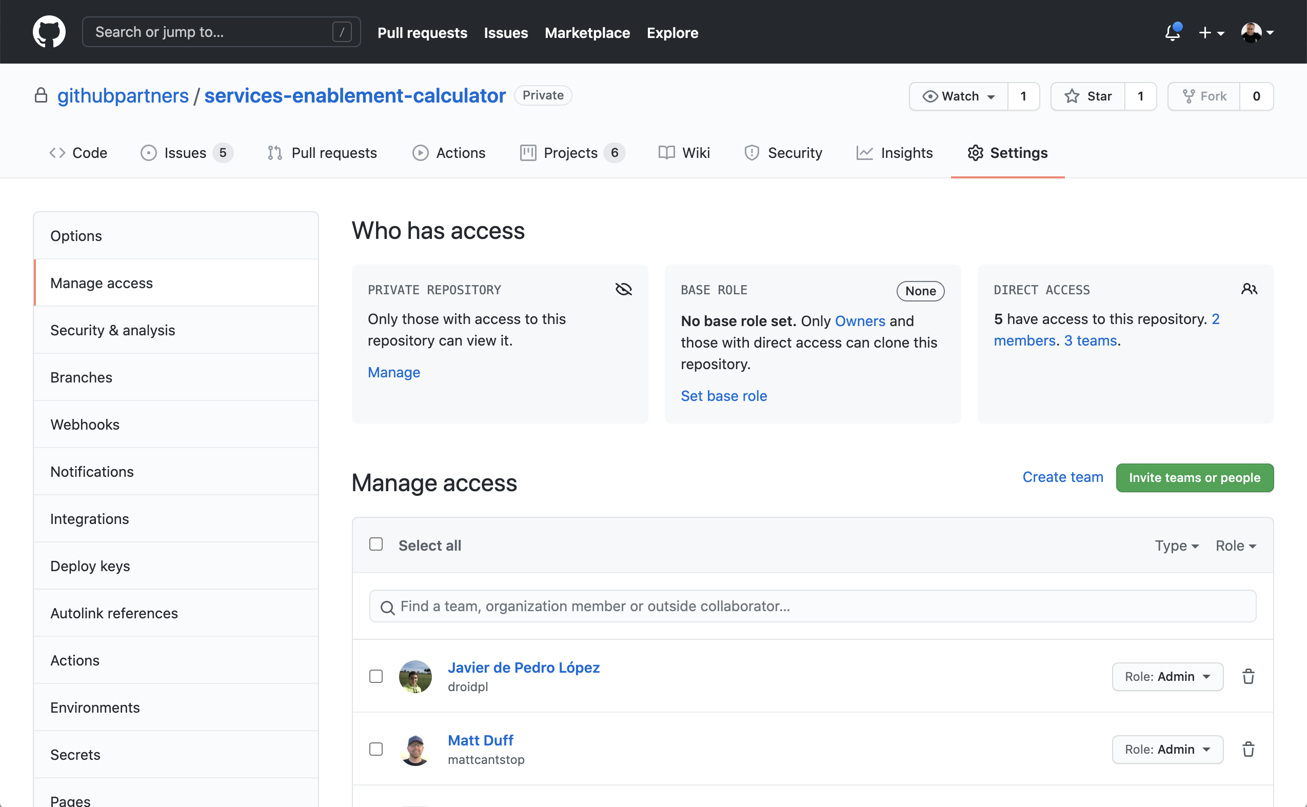
Manage repository access
Notes:
We have also updated the UI to give a better view at precisely who has access
Managing access for the repository
You can add:
Members, owners
Teams
Outside collaborators
Reference: https://github.com/githubpartners/services-enablement-calculator/settings/access

Slide 33

Permission levels for a repository
Level | Description
Read | Recommended for non-code contributors who want to view or discuss your project
Triage | Recommended for contributors who need to proactively manage issues and pull requests without write access
Write | Recommended for contributors who actively push to your project
Maintain | Recommended for project managers who need to manage the repository without access to sensitive or destructive actions
Admin | Recommended for people who need full access to the project, including sensitive and destructive actions like managing security or deleting a repository
Notes:
You can customize access to each repository in your organization with granular permission levels, giving people access to the features and tasks they need.

Slide 34
Team best practices

Slide 35

Team best practices
Collaboration and integration
Separation of repositories and permissions
Create a hierarchy for product families, features, responsibilities or areas of expertise
Notes:
Teams allows for greater flexibility for collaboration and integration, as well as separation of repositories and permissions
Create a hierarchy with nested teams for our applications, create communities of practice, invoke logical groupings of functional areas, as well as manage our teams of people effectively
Typically recommended to use for:
Product families or features
Areas of expertise or responsibility

Slide 36
Team best practices
Org / javascript-devs
org/security
org/SQL
DevGroup A
Dev Group B
Dev Group C
Notes:
Remember that one user can be a member of many teams.
To get the most out of teams, create teams along several axis:
Team structure
Expertise/interest
Project groups
Note that once you have joined a team, you will automatically receive notifications directed to that team.

Slide 37
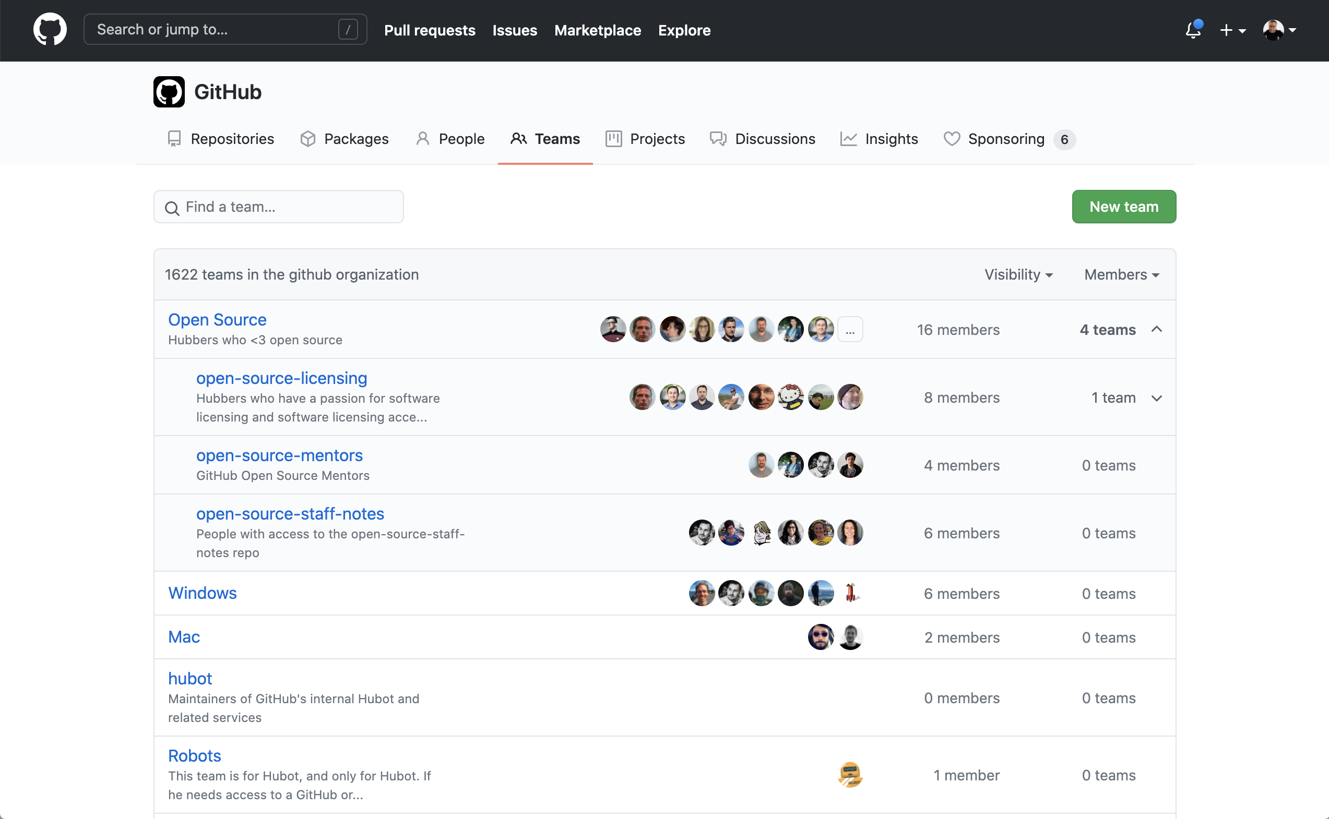
Nested Teams
Notes:
Teams in an organization can be nested. We recommend to group by product or function first. You can also designate team maintainers. Note that teams can be @mentioned and also assigned to issues.
********************
Resources:
https://docs.github.com/en/github/setting-up-and-managing-organizations-and-teams/giving-team-maintainer-permissions-to-an-organization-member
https://github.com/orgs/services-business-hosted/teams
********************

Slide 38
Questions
Notes:
********************
Note to presenter:
The questions below are for your reference only. They are ones that you can anticipate receiving from the audience. However, there is no need to pose these to your audience.
********************
Q: How do you handle losing the owner of an org? Can we somehow inject a new owner without having the original owner around?
A: I believe that site administrators or enterprise admins can manage this
If you fully lost the access to the org and nobody has it, you can always contact support to regain it
Q: Which roles are policy administrators? Owners?
A: Admins & Owners
Q: Is there any kind of ultimate role/permission that gives you access to everything in an Enterprise? All orgs, repos etc..
A: Admins & Owners
Q: In many orgs, going from TFS on prem to Azure DevOps services there is usually a shock as more people have access and visibility. Many enterprises want to limit access/visibility and control that. Trust by Default can be a hard sell to those people from security/auditing... Many times we have to do lots of education. How do you guys approach that in these cases?
A: I usually would ask them their primary concerns and needs, and see their reasoning behind their policies. Then I would think through how we could satisfy their primary concerns while being as open as possible.
Q: We try to do the same, so you've run into this as well?
A: Usually having really strong protected branches would satisfy concerns about contributions that were harmful.
For visibility concerns, we would talk through those as well and usually lock down the repositories that were sensitive.
Yes, for sure. Very common concern for us as well.
But usually their requirements don't require as heavy handed practices as they are recommending, so we show how we can have more of an open source/inner source style approach, while still ensuring their security requirements are maintained.

Slide 39
UI walkthrough

